Slide 1


IDS 1721
Computing and Problem Solving for STEM
Chapter 05
Abstraction

Slide 2
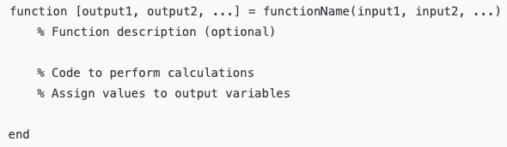
Recall
In MATLAB, functions are written in a file with the .m extension and have a specific syntax.
Each function file typically begins with the function keyword, followed by the output variable(s), the function name, and the input variable(s).

Slide 3
Steps to Create a Function
Define the Function Signature: Start with the function keyword.
Specify Outputs: Put any output variables in square brackets [ ] before the equals sign.
Name the Function: This must match the filename for MATLAB to recognize it.
Specify Inputs: List any input variables in parentheses ( ).
Write the Function Code: Add the calculations or operations the function should perform.
Assign values to output variables.
End the Function: MATLAB automatically terminates functions at the end of the file, but you can use end for readability.

Slide 4
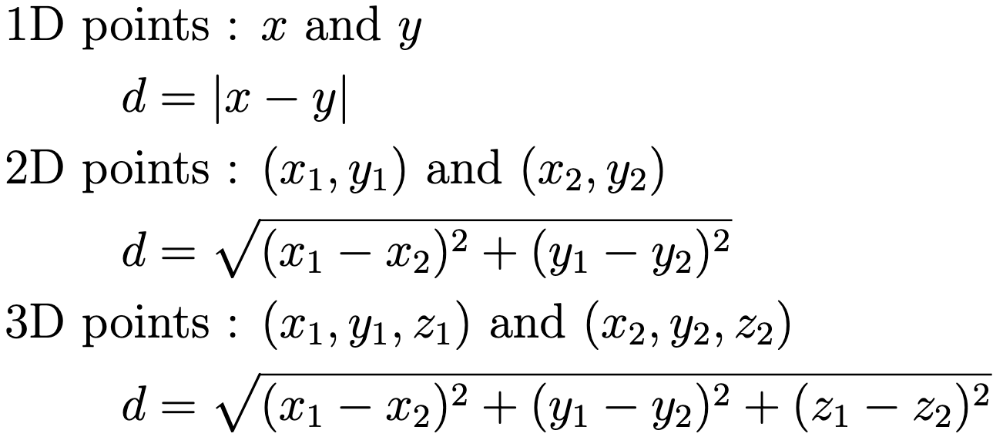
Exercise 1: Calculate distance
Task: Write a function called distanceBetweenPoints that calculates the Euclidean distance between two points.
Inputs: Two vectors representing coordinates of two points in either 1D, 2D or 3D space.
Output: Distance between the two points.
Formula:

Slide 5
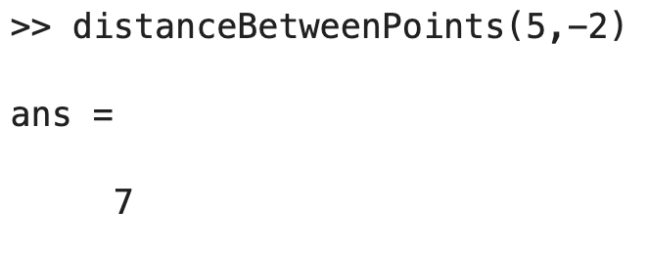
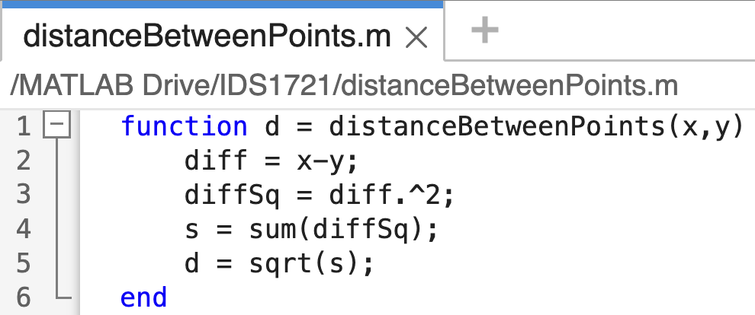
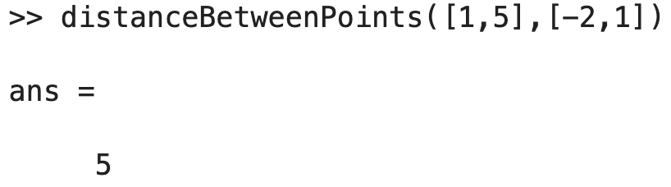
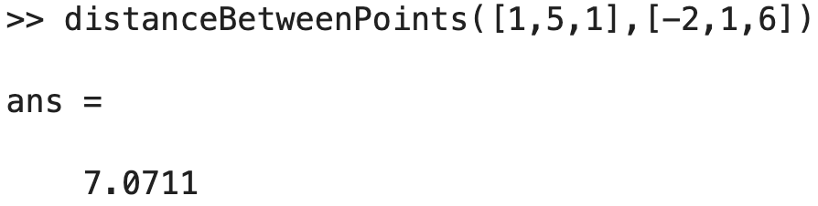

Slide 6

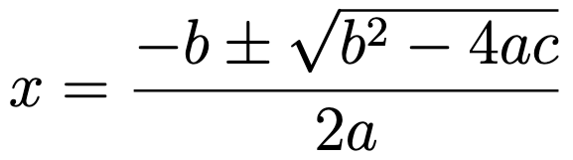
Exercise 2: Quadratic Equation Solver
Task: Write a function called quadraticSolver that solves a quadratic equation of the form
Inputs: Coefficients a, b, and c.
Outputs: The roots of the equation (real or complex).
Formula:

Slide 7
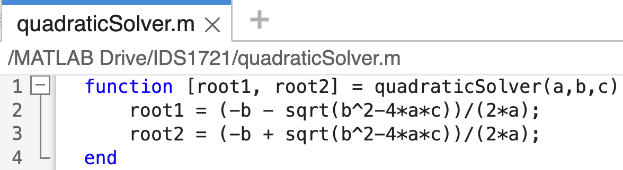
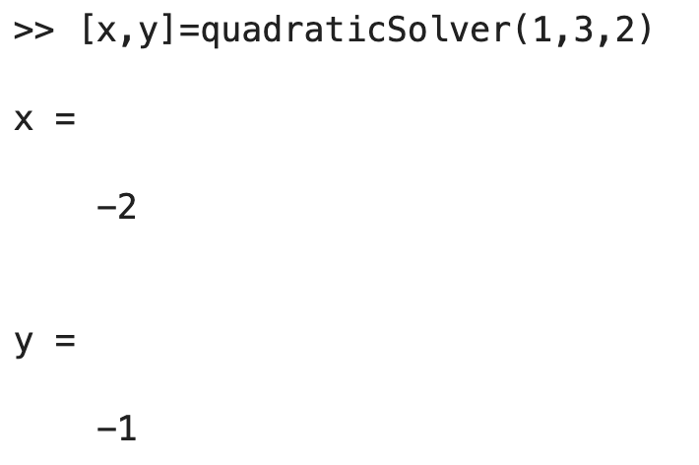

Slide 8
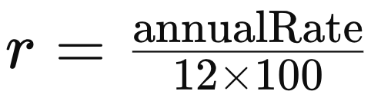

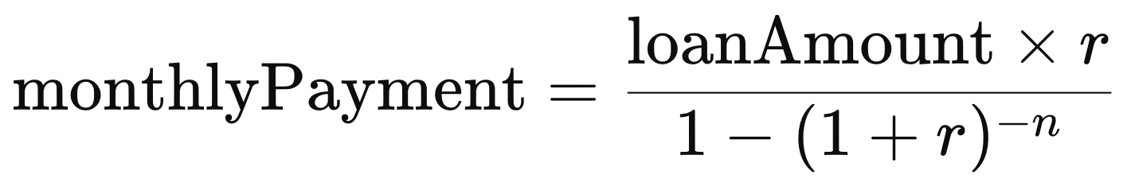
Exercise 3: Financial Calculator
Write a function named loanCalculator that calculates the following:
Monthly Payment: The amount to be paid each month.
Total Payment: The overall payment over the loan period.
Total Interest Paid: The amount of interest paid over the loan period.
Inputs : loanAmount, annualRate, years
Outputs : monthlyPayment, totalPayment, totalInterest
Formulae
Monthly Interest Rate:
Number of Monthly Payments:
Monthly Payment:
Total Payment:
Total Interest:

Slide 9
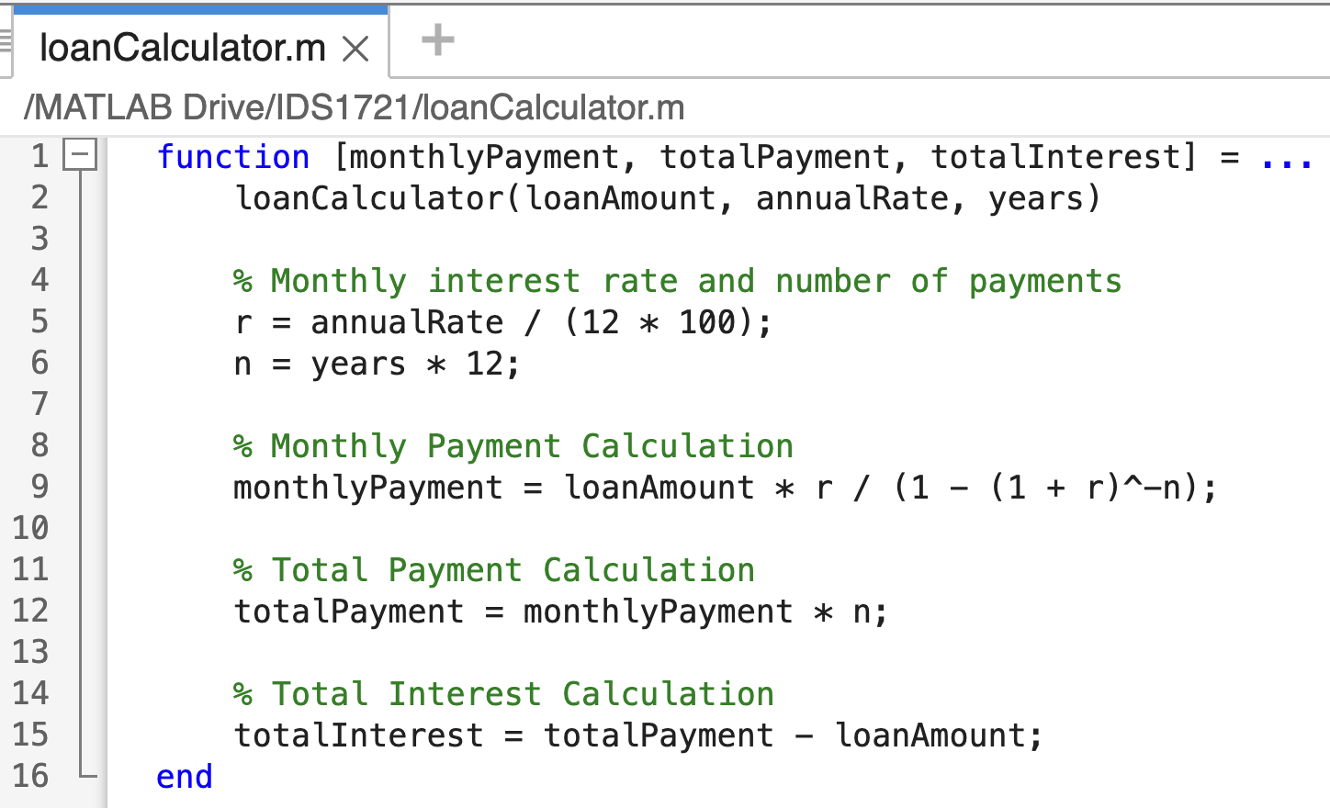

Slide 10
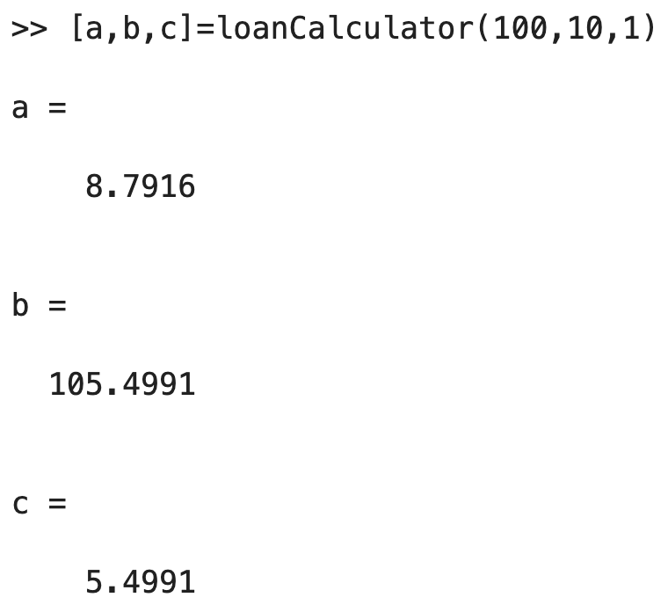
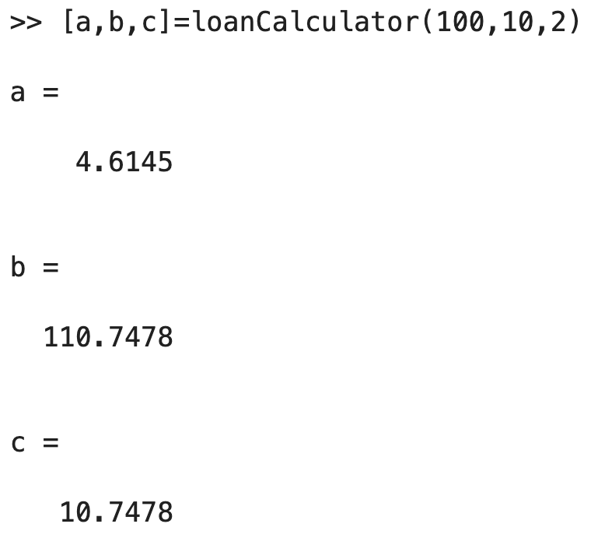
Check the loan calculator

Slide 11
Subfunctions
A subfunction is a secondary function defined in the same file as a primary (or main) function. Subfunctions allow you to organize and modularize code, making it more readable and reusable. The key points about subfunctions are:
File Structure: The primary function is the first function in the file, and all subsequent functions are subfunctions.
Visibility: Subfunctions are only accessible within the file they are defined in. Other scripts or functions cannot directly call a subfunction.
Usage: Subfunctions are useful for breaking down a complex task handled by the main function. Each subfunction can perform a specific part of the computation.
Syntax: The syntax for creating a subfunction is the same as for a main function, but it must be placed after the main function in the same file.

Slide 12
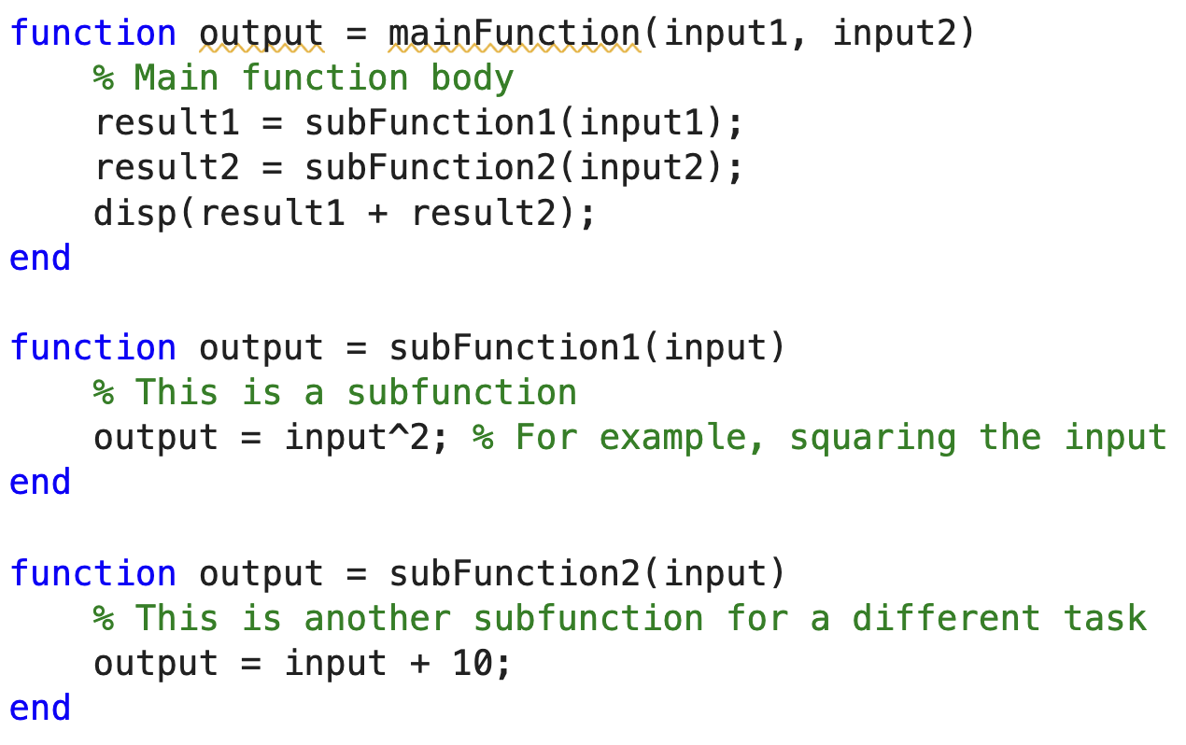
mainFunction.m

Slide 13
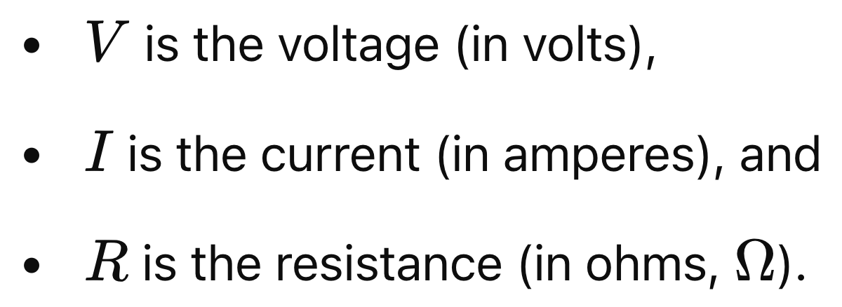

Circuit Resistance
In electrical circuits, resistance is the property that opposes the flow of electric current.
Resistance depends on the material, dimensions, and temperature of the conductor.
Different configurations of resistors, like those in series and parallel, affect the total resistance of the circuit.
It is a crucial factor in determining how much current flows for a given applied voltage, as described by Ohm’s Law

Slide 14
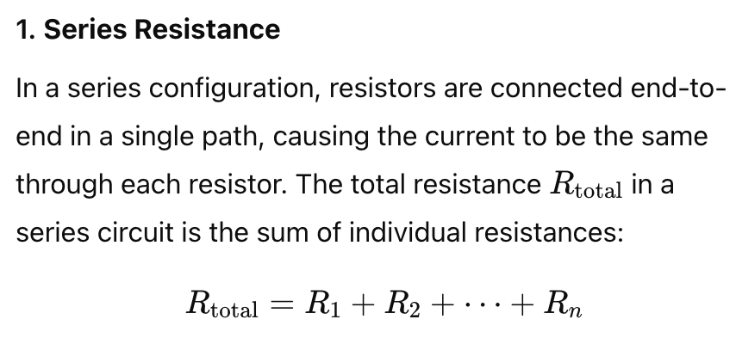
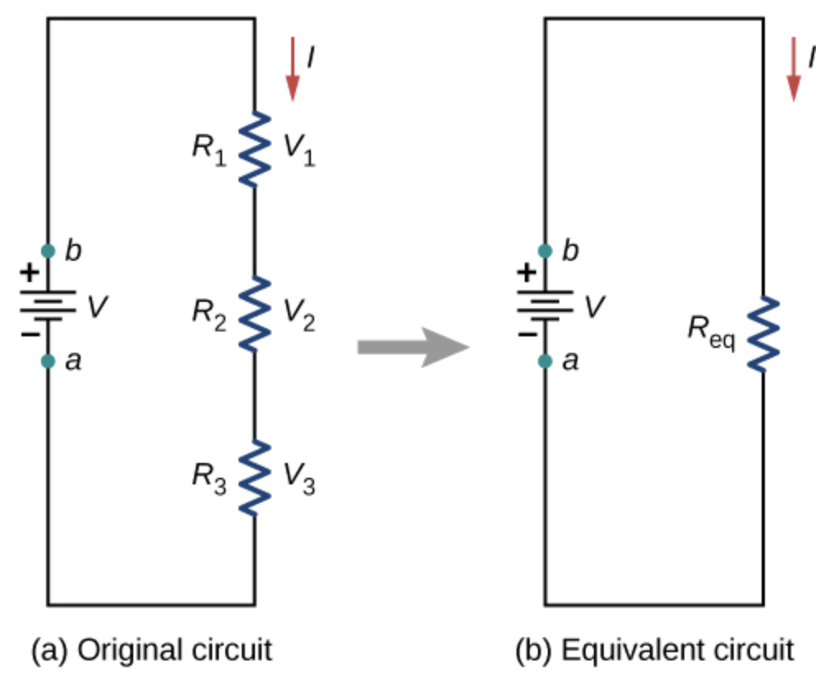

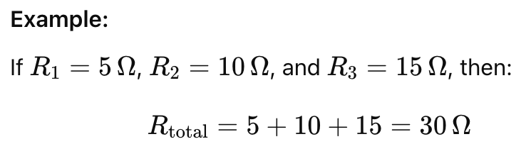
Types of resistance configurations
Most circuits have more than one resistor.
If several resistors are connected together and connected to a battery, the current supplied by the battery depends on the total or equivalent resistance of the circuit.

Slide 15
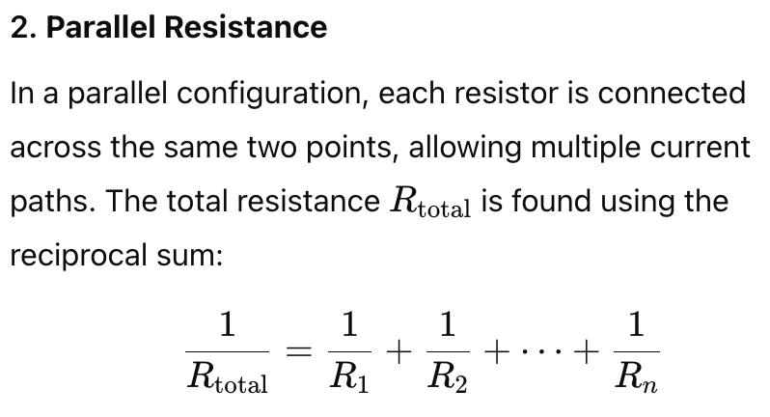
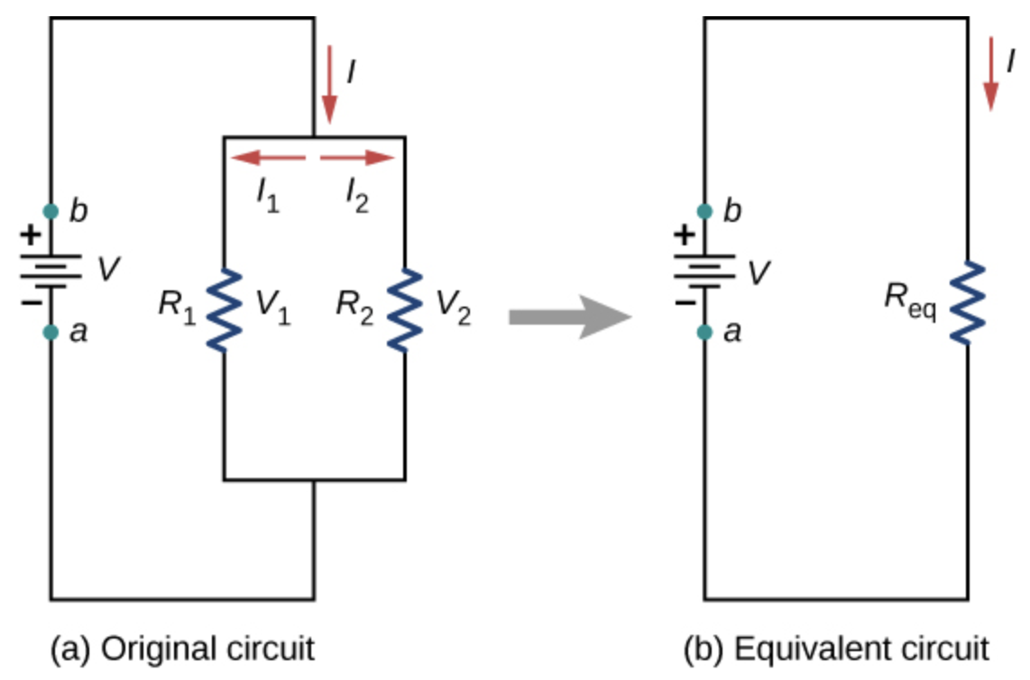
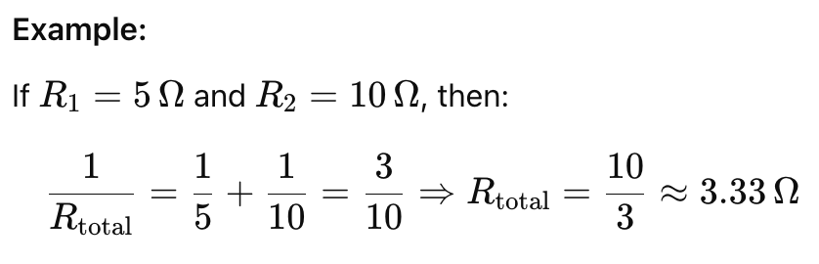
Types of resistance configurations

Slide 16
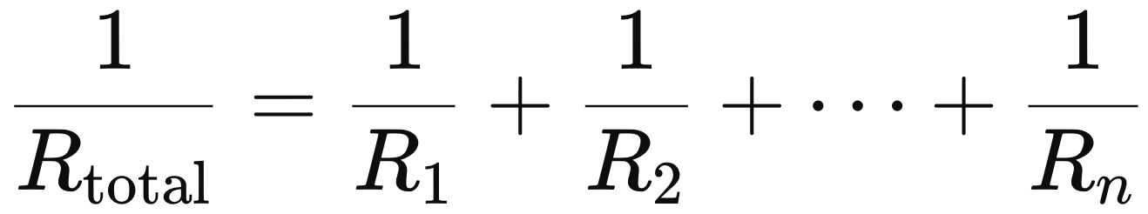
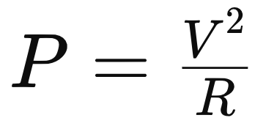
Exercise 4: Electrical Circuit Analysis
Write a main function circuitAnalysis that calculates the total resistance, total current, and power for a circuit using the voltage as input. Users specify if resistors are connected in series or parallel.
Details:
Main Function: circuitAnalysis
  Prompt the user to enter the number of resistors and their values.
  Ask if the resistors are in series or parallel.
  Call appropriate subfunctions based on the configuration.
  Subfunctions:
Series Resistance Calculation:
  Subfunction name: seriesResistance
  Input: Array of resistor values
  Output: Total resistance
Parallel Resistance Calculation:
  Subfunction name: parallelResistance
  Input: Array of resistor values
  Output: Total resistance
Power Calculation:
  Subfunction name: calculatePower
  Inputs: Total resistance and voltage
  Output: Power consumed

Slide 17
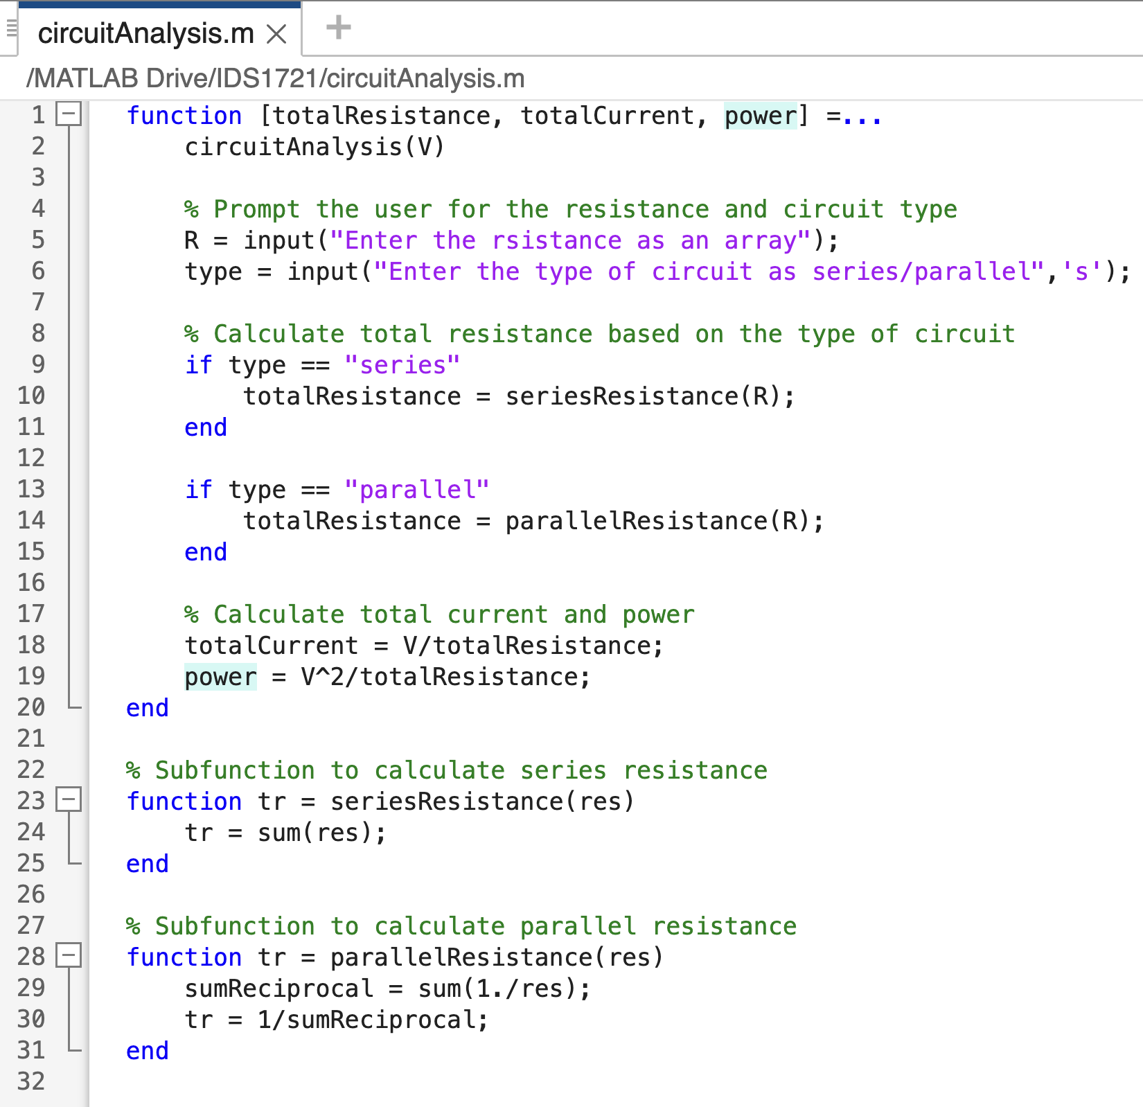
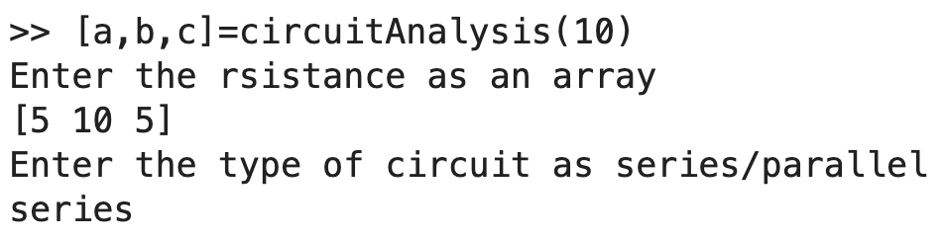
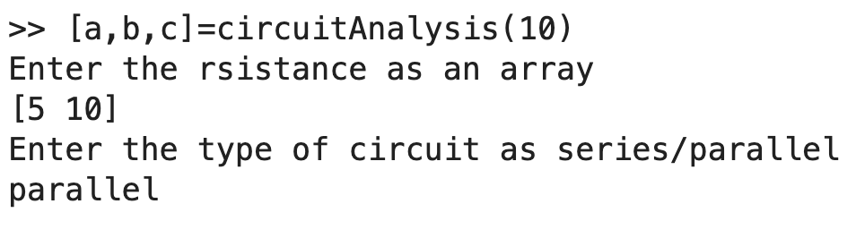
Try the following cases

